Slide 1
LLM Strengths & Limitations
Large language models feature powerful natural language processing and pattern recognition, but they struggle with factual accuracy, deep reasoning, and contextual limits.
Output from Google’s LLM (Gemini) to “LLM strengths limitations”
LLMs are great for a first draft but should never be the final draft (w/o expert review).
LLMs are non-deterministic meaning different outputs are produced with the same input.
  Should not be used for maintaining strict data governance, tracking metrics, or standardizing business logic.

Slide 2
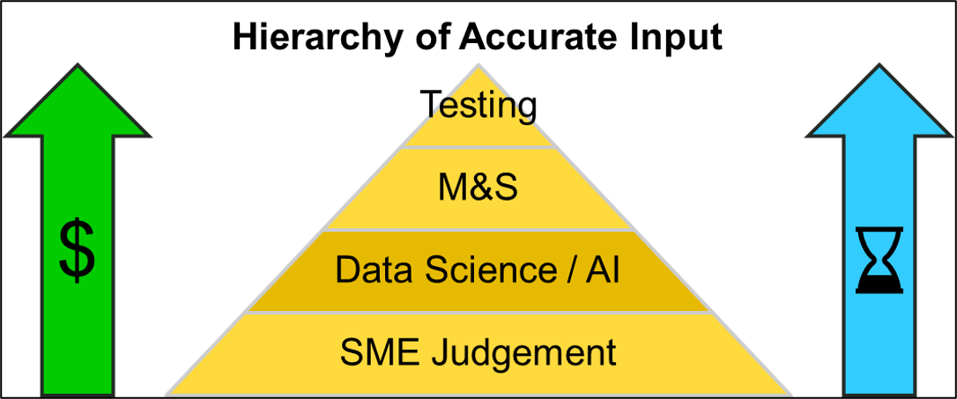
AI/ML Methods & Synthetic Data
Data Science / AI will have a similar impact to M&S as M&S has had on testing.
  Will not eliminate but likely reduce its need.
Traditional AI/ML methods (e.g. artificial neural networks) can be used to generate synthetic data.
  No need for expert review or consideration of token costs (such as w/ LLMs).
Historically the US Army has high quality data from testing/M&S but low in quantity. Generation of synthetic data can significantly expand the existing data.
  AI/ML methods produce confidence scores for the synthetic data.
  Acts as an advanced look-up table.

Slide 3
Why Use Power BI?
Three significant reasons to use Power BI:
Create interactive visuals and enhanced methods of analysis.
  – Provides a “prettier picture” (e.g., easier to understand).
Provides an improved method for data analysis.
  – Particularly when dealing with large sets of data.
  – Great for exploratory data analysis.
Easier for the end user to work with.
  – Less back-and-forth work associated w/ “PowerPoint Engineering”.
  – Can embed into PowerPoint, SharePoint, and MS Teams.
Power BI is nearly as easy to use as Excel, virtually as capable as MatLab / Python, and freely available to the US government.
Power BI empowers the end user to make data-driven decisions in ever-changing situations.

